Slide 1
ADVANCED PROGRAMMING CONCEPTS
Lecture 09: Names, Bindings and Scopes
Dr Jiacheng Tan
School of Computing
University of Portsmouth

Slide 2
Introduction
In the next few lectures, we will study the following programming language concepts:
  variables, declarations and memory allocation
  elementary and compound data types;
  statements, procedures, modules and abstract data types.
The aims of this study are primarily to give you:
  an appreciation of the common features of languages, and how languages can differ.
We will concentrate only on imperative programming languages, using C, Java or others as illustrative examples.

Slide 3
Variables
A variable is a place holder for values at program run-time.
It has several attributes at run time.

Slide 4
Variables
A variable, at program run-time, has attributes that include:
  a name.
  an address, which is also called its l-value because the address is what is required when the name of variable appears in the left side of an assignment.
  a value: the contents of the memory cell (s), also called its r-value of a variable.
  a type, which determines the range of values the variable can store and the operations that are defined for the values
  a life time: the time during which a variable is bound to a specific memory location (i.e., its address).
  a scope: the range of statements in which the variable is visible/accessible.

Slide 5
Explicit/Implicit Declaration
In most languages variables are introduced using a declaration.
Declaration can be done explicitly or implicitly.
An explicit declaration is a program statement used for declaring the types of variables. E.g., a variable i is declared:
  in Pascal: i : integer
  in Java int i;
  In Fortran: INTEGER :: Count

Slide 6
Implicit Declaration
An implicit declaration is a default mechanism for specifying types of variables through default conventions, rather than declaration statements
E.g., Fortran has both explicit and implicit declarations
  Explicit
    INTEGER :: Count, Total (Or in Fortran 77: INTEGER Count)
    REAL :: Average, SUM
    COMPLEX :: c
  Implicit: The default implicit typing rule is that if the first letter of the name is I, J, K, L, M, or N, then the data type is integer, otherwise it is real.

Slide 7
Cont’d
Another kind of implicit type declaration is type inference
  E.g., in JavaScript and C# a variable can be declared with var and an initial value. The initial value sets the type
  Of course, for this to work an initial value must be provided.
Note: type inference (a way to declare a type) is different from reference type (a data type, e.g., pointer type)

Slide 8
Binding
A binding is an association between an entity and an attribute, e.g.,
  between a variable and its type, value or memory location, or
  between a symbol (e.g., +) and an operation.
Binding time is the time at which a binding takes place.
Binding can take place at different times

Slide 9
Binding Time: Examples
Consider the following Java statement:
count=count+5;
  The type of count is bound at compile time (because Java is a typed language, a variable must be declared before it being used)
  The range of possible values of count is bound at compiler design time
  The operation (semantics/meaning) of operator + is bound at compile time when the types of its operands have been determined
  The value of count is bound at execution of the statement, i.e., at runtime.

Slide 10
Cont’d
Binding can also take place at load time or link time:
  Load time – bind a C or C++ static variable to a memory location)
  Link time – bind the variables in one module with those in the other modules

Slide 11
Type Binding
A type binding is static if it occurs before runtime and remains unchanged throughout program execution.
  If declarations (implicit or explicit) always carry type information, binding can be done at compile time
  Such languages (e.g., Java & Pascal) are said to be statically typed.

Slide 12
Cont’d
A type binding is dynamic if it occurs during execution or can change during execution of the program (specified through an assignment statement).
  e.g., Python, JavaScript, PHP
Advantage: flexibility (generic program units)
Disadvantages:
  High cost (dynamic type checking and interpretation)
  Type error detection by the compiler is difficult

Slide 13
Strong and Weak Typing
If all type bindings are static, then nearly all type error (e.g., the application of an operator to an operand of an inappropriate type) can be detected by the compiler – we say the programming language is strongly typed
If type bindings are dynamic, type checking by compiler is almost impossible, then we say the programming language is weakly typed

Slide 14
Block Structure of Programs
To understand how bindings behave, we now introduce the concept of block.
A property shared by almost all modern imperative programs is their block structure.
A block is a section of code, denoted with start and end markers, which can contain declaration of variables local to that region and has its own reference environment (i.e., the accessible identifiers )
  in Pascal by begin and end; and
  in Java by { and }.

Slide 15
Cont’d
Blocks are also typically nested;
  e.g. in Java and C:
    method blocks are always nested within class blocks; and
    other code blocks can be nested within methods.
  But in Java & C, you cannot nest methods within a method.
  In Python and Pascal, procedures (have no return value) and functions (have return values) can be nested.
Since blocks contain variable declarations, we need to consider the reference environment and the scope of identifiers and variables in name resolution (i.e., the process of deciding the attributes of an identitier)
  where these variables can be used?
  what happens if we have two variables of the same name?

Slide 16
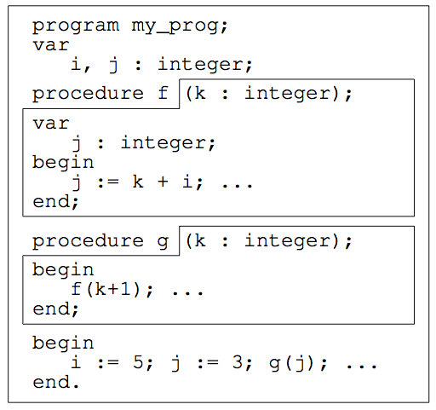
Scope of Variables
The scope of an identifier (e.g. a variable or a procedure) is the part of the program text that can access that identifier.
Consider a Pascal program

Slide 17
Cont’d
In most languages, an identifier’s scope is the block where it’s declared.
For example, in the program above:
  the variable i declared in the outermost block is a global variable (its scope is the whole program).
  The scope of procedure f’s parameter k and local variable j is the body of f.
  the use of variable j in f is bound to its local declaration.
  the procedures f and g are declared in the outermost block and are therefore both global.

Slide 18
Visibility Rule
A declaration in an inner block hides a declaration of a variable in an enclosing block with the same name – this is the visibility rule adopted by most languages with blocks.
For example, if a local variable is declared with the same name as a global variable, then it hides the global variable.
  In the above program, the local variable j in procedure f hides the global variable j.
  In this case, we say there is a hole in the scope of the global variable j (i.e. its scope is the whole program except procedure f).

Slide 19
Static and Dynamic Scoping
In the previous example, the scopes of variables are governed by the visibility rule, therefore
  scopes of variables depend on the lexical (i.e., its layout) structure of a program, thus
  it is possible for compiler to determine the scopes of all variables.
This is called static or lexical scoping.
In contrast, with dynamic scoping, the reference environment (visibility of identifiers) depends on the calling sequence of subprograms, not the layout of the nesting structures. Thus, the scopes of identifiers can be determined only at run time.

Slide 20
Example
Consider the following (JavaScript-like) function, big, in which two functions sub1 and sub2 are nested:
  function big() {
  function sub1() {
  var x=7;
  sub2();
  }
  function sub2() {
  var y=x;
  }
  var x=3;
  sub1()
  }
  Which x is referenced when sub2() is called?

Slide 21
Case 1: Static Scoping
With static scoping, as in most languages, the reference to x in sub2 is to the x declared in big
The search for x begins in function sub2, where the reference occurs, but no declaration for x is found there.
The search continues to the static parent of sub2, big (i.e., var x=3).
If there is no declaration of x in big, then an error is generated. The x declared in sub1 is ignored.

Slide 22
Case 2: Dynamic Scoping
With dynamic scoping, the meaning of x in sub2 depends upon the calling sequence and cannot be determined at compile time.
Consider two different cases:
  big() calls Sub1() and sub1() in turn calls sub2. The search for x begins in sub2, then to its caller (its dynamic parent), sub1, where x is declared (x=7) and found.
  big calls sub2. The search for x begins in sub2, then within its caller, big, where x is declared (x=3).
function big() {
function sub1() {
var x=7;
sub2();
}
function sub2() {
var y=x;
}
var x=3;
sub1()
}
function big() {
function sub1() {
var x=7;
sub2();
}
function sub2() {
var y=x;
}
var x=3;
sub2()
}

Slide 23
Static v.s. Dynamic Scoping
Dynamic scoping is not popular
  Less reliable program. Subprogram are always executed in the environment of all previously called subprograms that have not yet completed their execution.
  Programs of poor readability
But it is easier to implement using stacks and resolving a variable does not require tracing the syntactic structure of the entire program.
Used by early versions of LISP (before Common LISP), but it is still an option in Perl & Common LISP.

Slide 24
Lifetime of Variables
The lifetime of a variable is the period when it “exists” and has a value during program execution.
The lifetime of a procedure’s local variable is the current execution of the procedure.
  It is created when the procedure is called, and is destroyed when the procedure exits.
  Each (recursive) execution of a procedure has its own copy of the local variables.
The lifetime of global variables is the whole duration of execution of the program.

Slide 25
Lifetime & Memory Allocation
The lifetime of a variable is related to how memory is allocated and deallocated for its values.
There are three basic memory allocation mechanisms, each associated with a different area of memory:
  static allocation is when a fixed memory address is retained throughout program execution( The lifetime of the variable is the entire program execution.
  stack-based allocation/deallocation is done on a last-in first-out basis and is used for procedure/function calls (the lifetime is the execution of the function).
  heap-based allocation/deallocation. Heap is a memory area where storage is dynamically allocated. Variables that are dynamically allocated from the heap are called heap-dynamic variables. They often do not have identifiers associated with them (anonymous variables) and thus can be referenced only by pointers or reference type variables (e.g., a variable for Java object is a pointer to a memory location rather than some values).

Slide 26
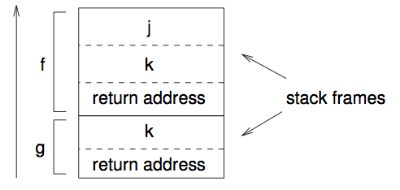
Memory Allocation
For the Pascal program above:
  Memory is statically allocated for the global variables i and j.
  (Memory addresses for these variables are determined at compile time, as are the locations of the machine code instructions.)
  Parameters and local variables are allocated on the stack; after the main body calls g, which calls f. This looks like:

Slide 27
Memory Allocation in Java
public class Account {
private static int nextAccNumber = 1000;
private int number;
private ArrayList transactions;
public Account() {
this.number = nextAccNumber++;
this.transactions = new ArrayList();
}
public void withdraw(double amount){
Transaction trans = new Transaction(-amount);
transactions.add(trans);
}
...
}

Slide 28
Cont’d
Objects in Java are allocated at arbitrary times using new.
Therefore, any object of type Account, which includes:
  instance variable number and transactions
  exists on the heap.
The nextAccNumber variable is static (not part of any object) and is therefore allocated statically.
Local variables amount & trans are allocated on the stack ...
but the object that trans references to is created on the heap.
  Heap memory is de-allocated automatically (e.g. when an object is not longer accessible) by the garbage collector.

